Slide 1
Welcome
PMA Annual Meeting
April 23, 2022 10:00am

Slide 2
Cheryl Jennings,
President of the Board

Slide 3
Zoom Instructions
Questions? Use Q&A feature
Links are being put in the chat
Links and recording will be sent in a follow up email

Slide 4
Megan Walker,
Secretary of the Board

Slide 5
Approval of last year’s Annual Meeting minutes

Slide 6
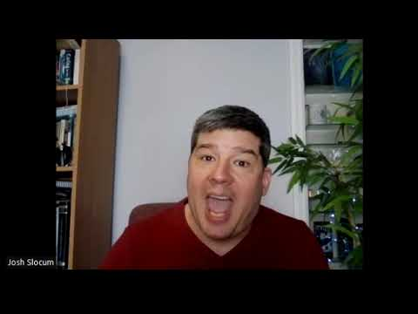
Funeral Consumers Alliance

Slide 7
Amanda Stock,
Executive Director

Slide 8
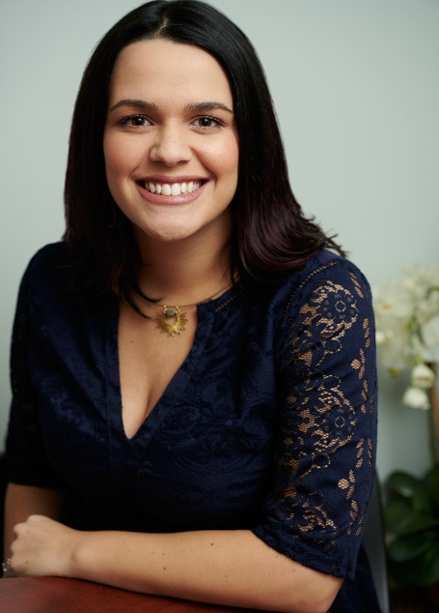
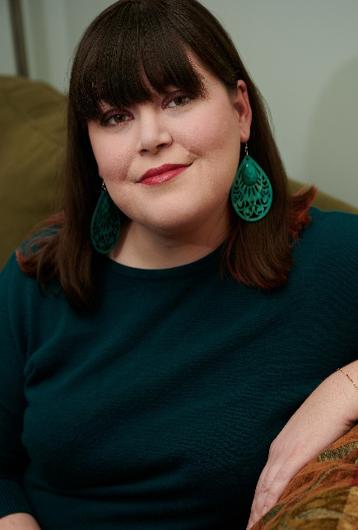
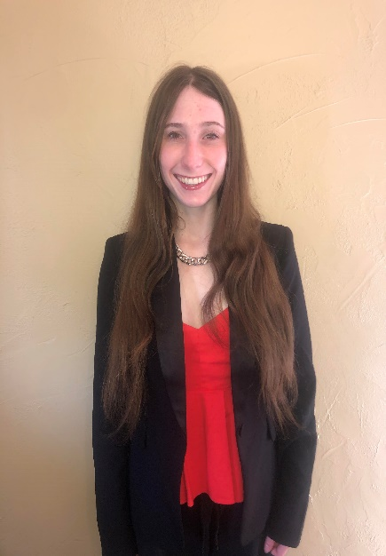
People’s Memorial Staff
Amanda Stock,
Executive Director
Beverly Tryk,
Communications Manager
Jessica Runner,
Business and Administrative Assistant

Slide 9
Funeral Financial Assistance Fund
$635 to help cover the cost of cremation, aquamation, or burial
Record breaking 27 families supported in 2021

Slide 10
Equity and Inclusion Committee
Dedicated to increasing the accessibility of PMA’s funeral education and advocacy resources to the diverse communities of Washington State.
PMA believes that end-of-life preparation and death care should be a right, not just a privilege. It is committed to assuring loving, respectful end-of-life support and death care that reflects the personal values and resources for all Washingtonians, regardless of their cultural, religious, and ethnic identities.

Slide 11
Looking Ahead
2022 Funeral Home Price Survey
Appointments required for member and staff safety
Virtual classes will continue
Make a gift during the Spring Fundraiser! Visit www.peoplesmemorial.org/donate.

Slide 12
New Ways to Support PMA
Donor Advised Fund: like a charitable investment account; provides an immediate tax benefit.
Qualified Charitable Distributions: tax-free gifts transferred directly from your IRA account to your favorite charity.
Gifts of Stock: avoid capital gains taxes and get an income tax deduction for the value of the stock.
Bequests: Including PMA in your Will.

Slide 13
Beverly Tryk,
Communications Manager

Slide 14
New Member Benefits
New contracted funeral homes in Bellingham and Central Washington
Two providers of natural organic reduction
Handcrafted urns made locally
70% of new members say they were referred by a loved one!

Slide 15
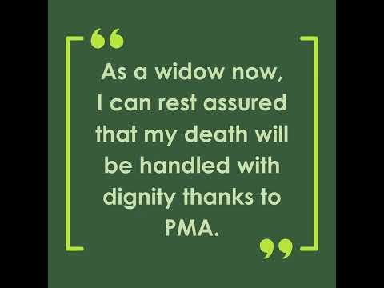
Satisfaction Surveys

Slide 16
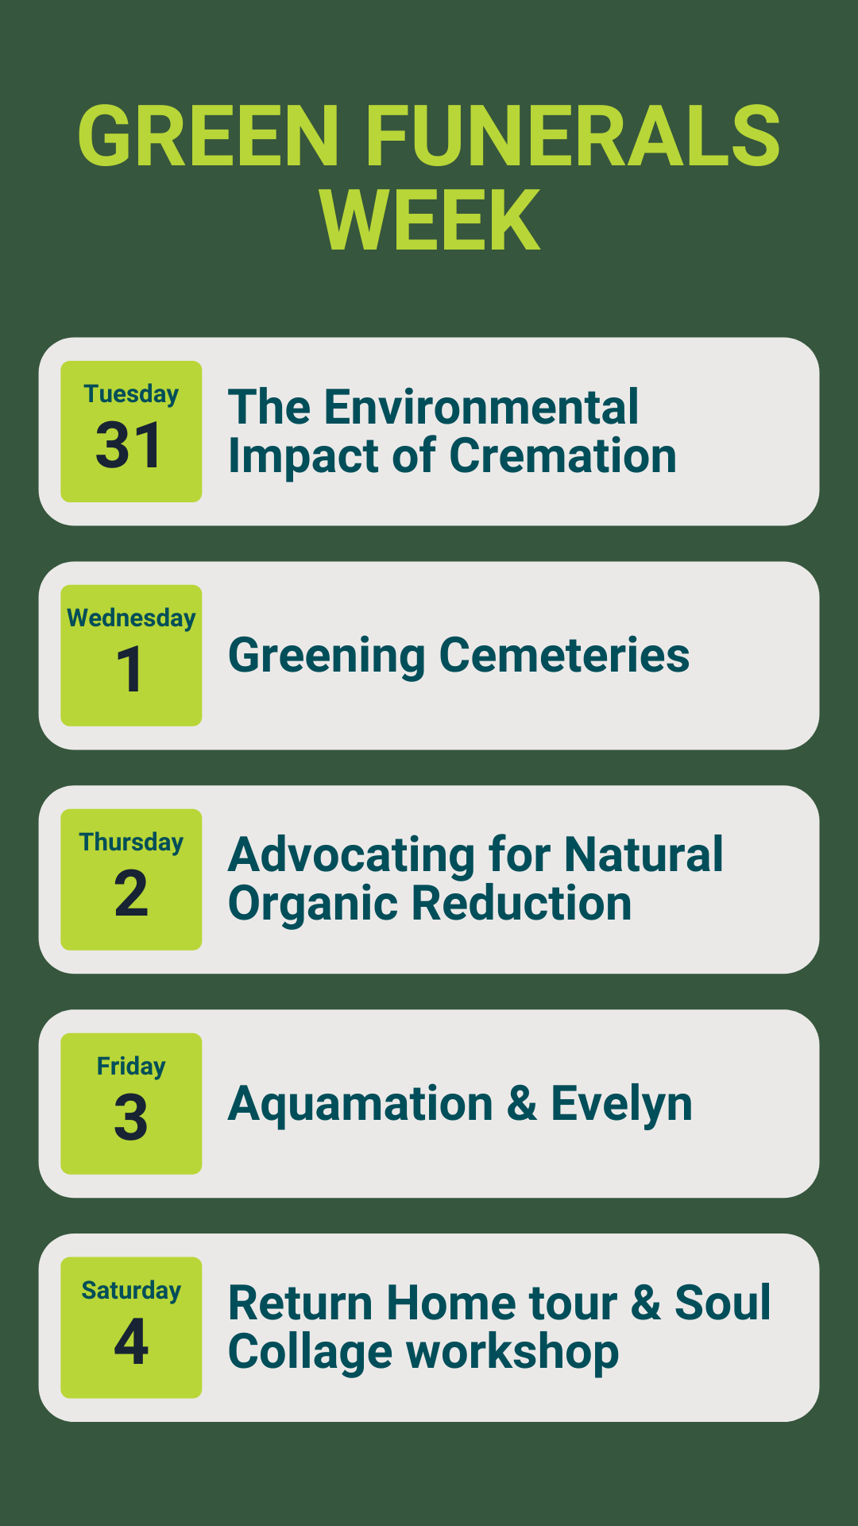

Slide 17
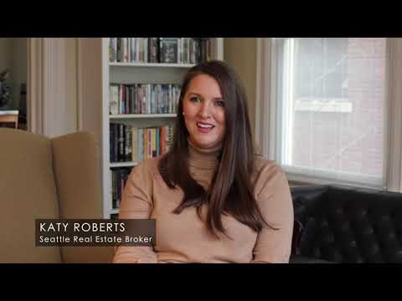
Katy Roberts

Slide 18
Kim Forsythe,
Managing Funeral Director

Slide 19
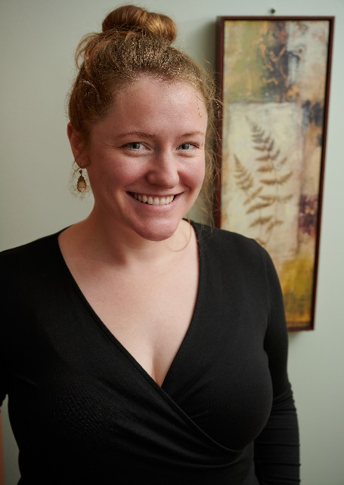
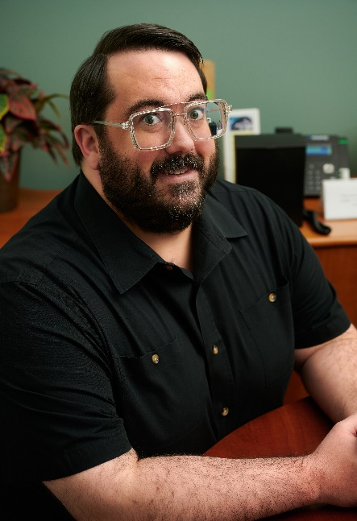
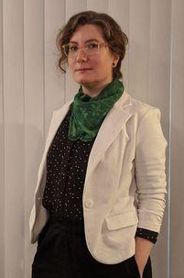
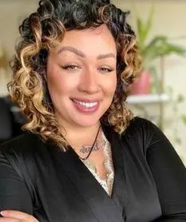
The Co-op Funeral Home Staff
Kim Forsythe,
Managing Funeral Director
Chris Ronk,
Licensed Funeral Director
Rachel LeBlanc,
Funeral Director Intern
Nissa Cooley,
Funeral Director Intern

Slide 20
Thank you to our sponsors
www.khbb.com
www.grouphealthfoundation.org
www.rekatyroberts.com

Slide 21
Ann Norman,
Treasurer of the Board

Slide 22
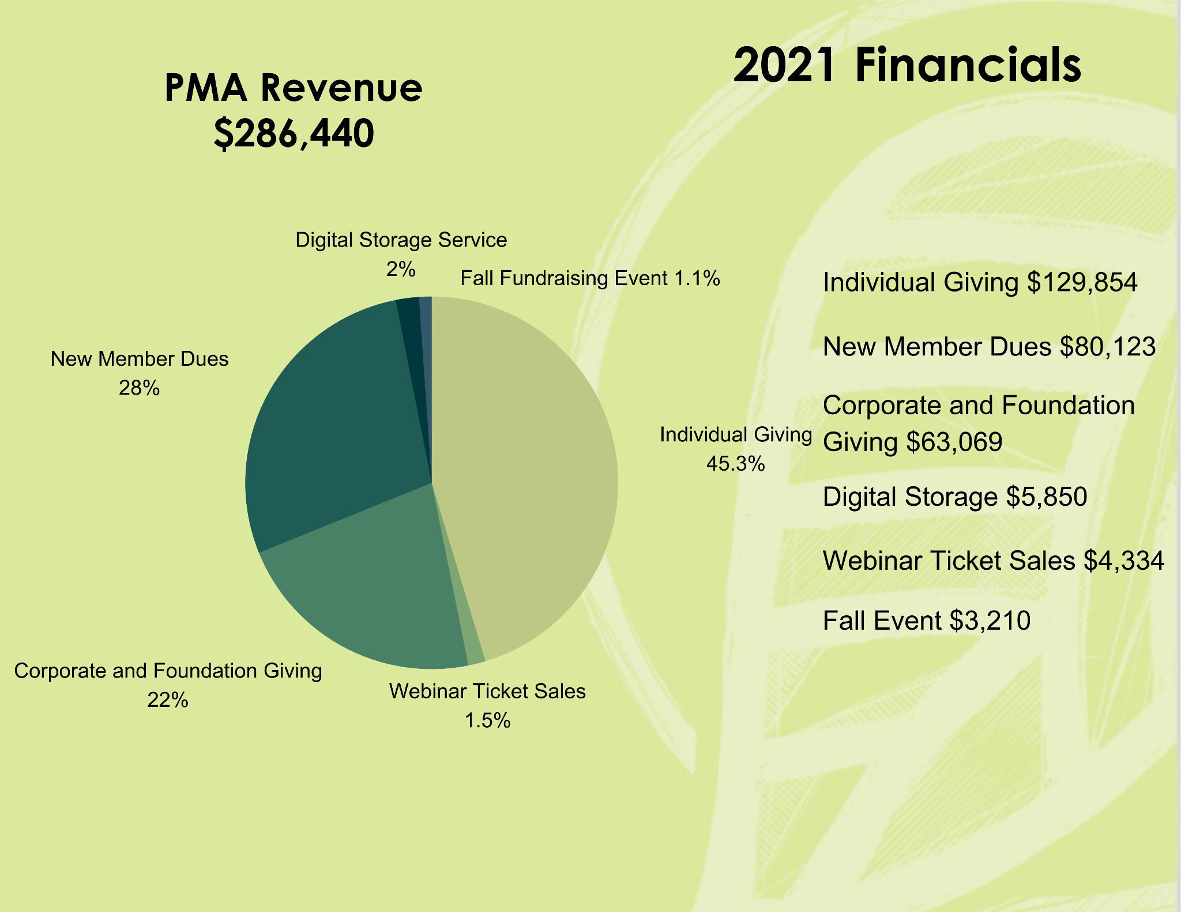

Slide 23
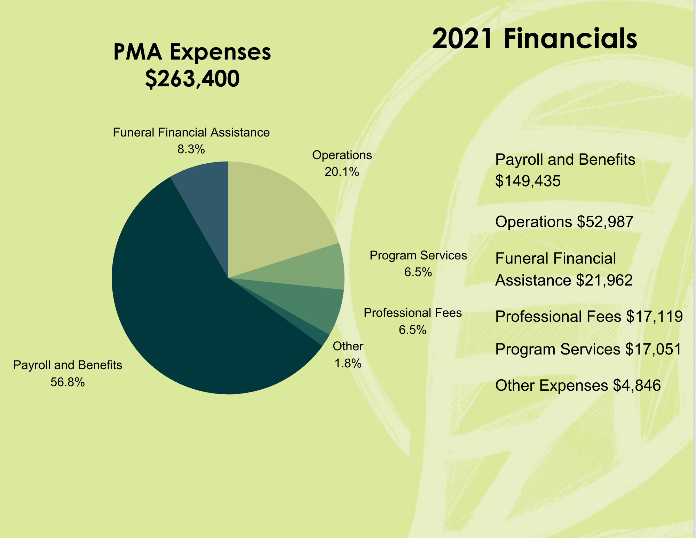

Slide 24
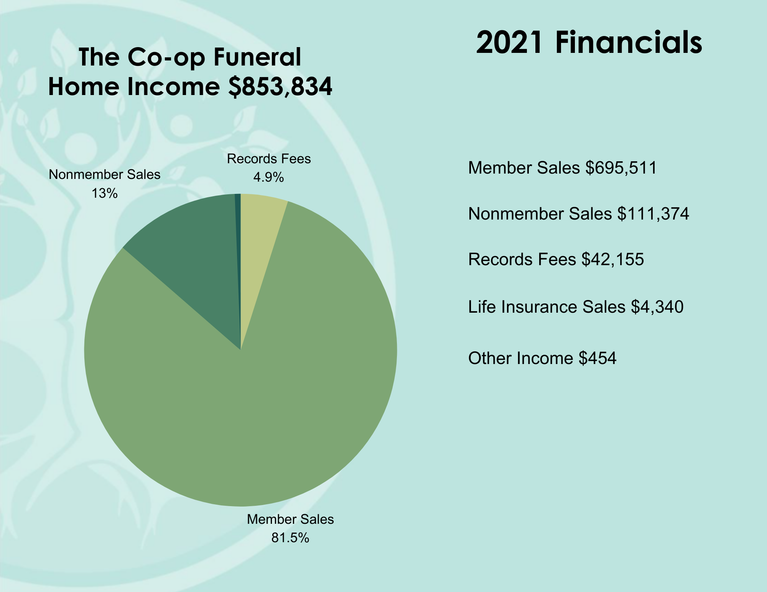

Slide 25
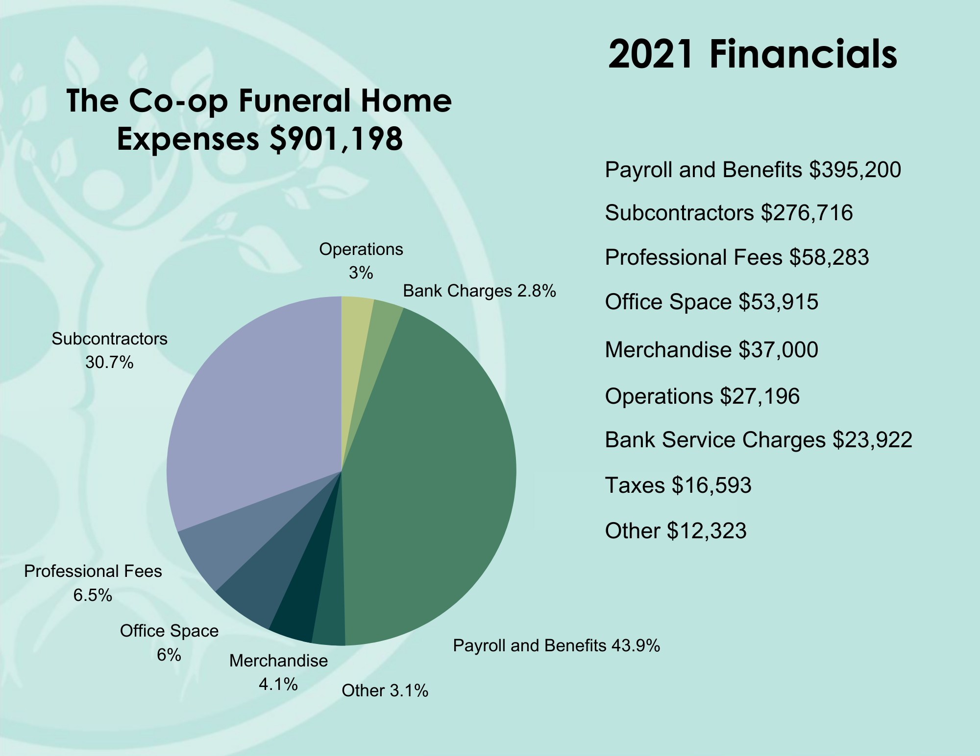

Slide 26
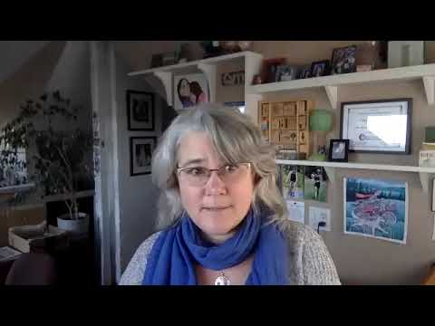
Volunteer of the Year presented by Carrie Andrews, Board Member

Slide 27
Erika Campbell,
Board Member

Slide 28
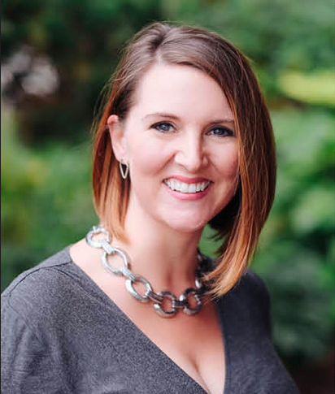
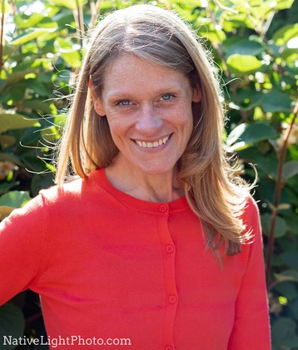
2022 Board Nominees
Katy Roberts
Wyvonne Ray
Andrea Fitzgerald

Slide 29
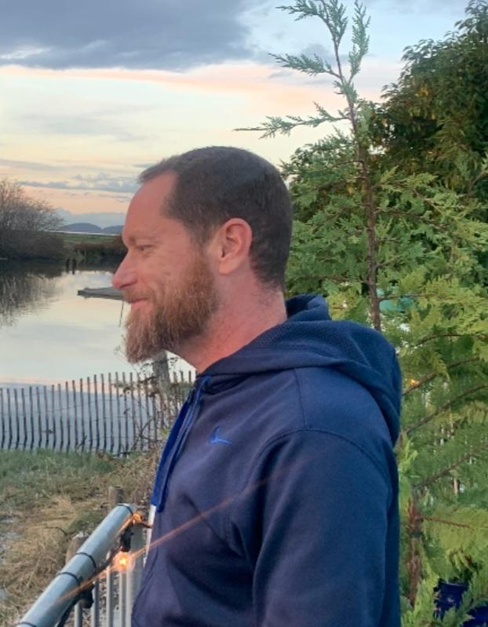
2022 Board Alternate Nominee
Scott Segel

Slide 30
Cheryl Jennings,
President of the Board

Slide 31
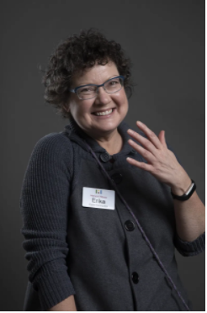
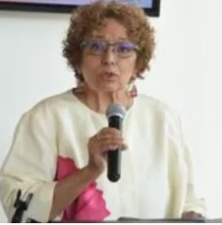
Retiring Board Members
Erika Campbell
June Michel

Slide 32
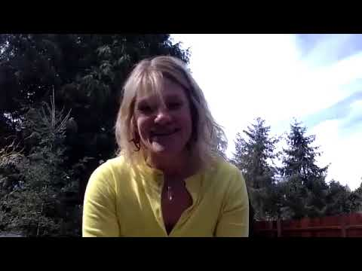
Andrea Fitzgerald, Board Member

Slide 33
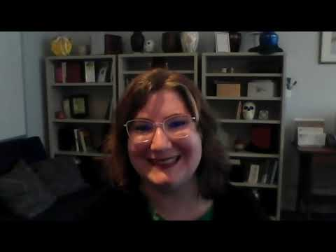
Rachel LeBlanc, Funeral Director Intern

Slide 34
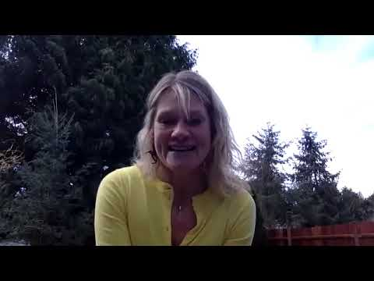
Andrea Fitzgerald, Board Member

Slide 35
Micah Truman,
Founder and CEO
Return Home

Slide 36
Cheryl Jennings,
President of the Board

Slide 37
Raffle Winner:
Congratulations!

Slide 38
Thank you to ALL of
our members!

Slide 39
People’s Memorial envisions a future where all of us have information about and access to death care options the reflect our values and resources.

